Slide 1
Population, Education, and the Future of Work in the Arab Region Side event at the 56th Session of the United Nations Commission on Population and Development April 12, 2023

Slide 2
Skills Mismatch and the Future of Work
Significant human capital not being fully utilized
Skills mismatch
Technical skills
Life skills
Technological disruption and COVID-19 pandemic

Slide 3
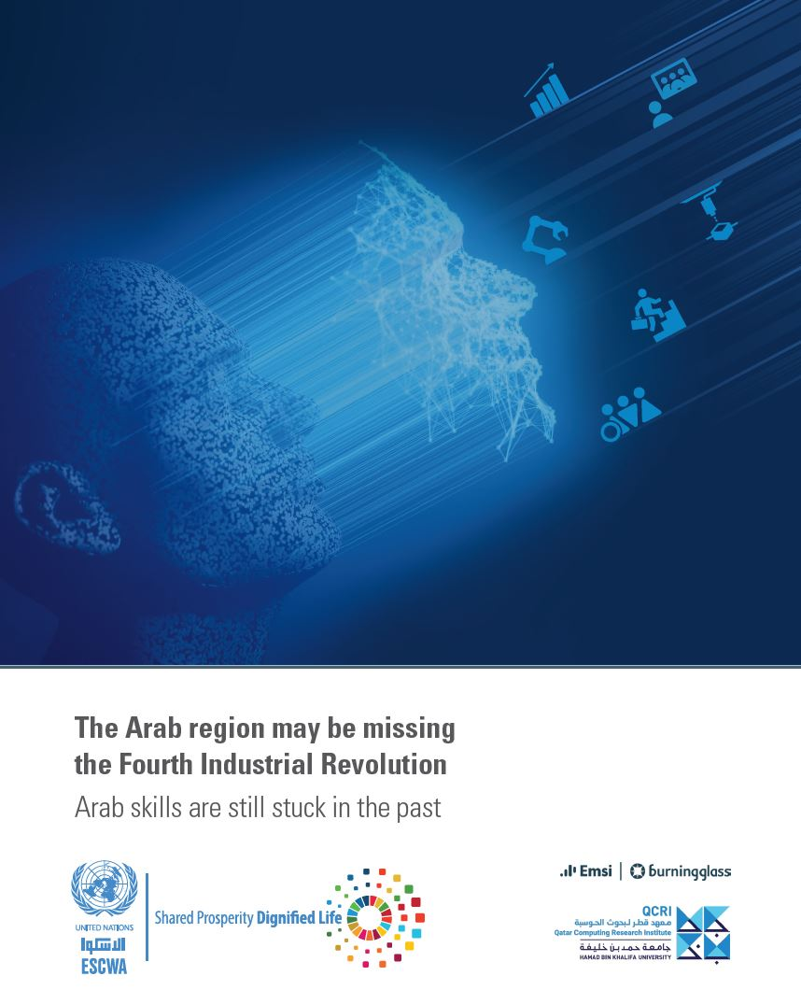
Key Findings
Large gap in technological adoption in the Arab region.
Accounting and restaurant operation skills remain the highest in demand, with an increasing trend.
Limited adoption of teleworking in the Arab region despite the COVID-19 pandemic.
Gender dynamics
55% of job advertisements target men compared to 32% that target women
Most in-demand female-targeted job openings are in entry-level jobs

Slide 4
Way Forward
Reform
education policies
Adopt
technological changes
Promote
remote working modalities
Reduce
labour market information gaps

Slide 5
Thank you

