Slide 1
Overview of NCDs Prevention and Control our Experience in Salt Reduction in Bread Palestine 2017

Slide 2
Major Disease Proportional Mortality Palestine 2017
Disease %
Heart disease 30.3
Cancer 14.7
Cerebrovascular diseases 11.7
Diabetes Mellitus complications 9.0
Respiratory disease 5.6
MoH , Annual health report 2017

Slide 3
Year | Cancer Deaths |  | Deaths of Diabetes Mellitus |  | Cardiovascular Deaths
 | % from Total Deaths | IR/100,000 | % from Total Deaths | IR/100000 | % from Total Deaths | IR/100000
2010 | 10.8 | 28.9 | 5.7 | 15.2 | 40.7 | 109.7
2011 | 12.4 | 34.9 | 8.6 | 24.2 | 35.9 | 101.0
2012 | 13.6 | 35.5 | 6.4 | 16.8 | 43.4 | 113.6
2013 | 13.4 | 36.8 | 6.1 | 16.8 | 44.2 | 121.7
2014 | 14.2 | 37.6 | 8.9 | 23.6 | 40.9 | 107.9
2015 | 14.1 | 41.9 | 9.9 | 29.4 | 40.6 | 120.2
2016 | 14.0 | 37.5 | 8.0 | 21.6 | 43.3 | 116.5
2017 | 14.7 | 41.3 | 9.0 | 25.2 | 42.0 | 117.8

Slide 4
Physical activity
 | Both Sexes | Males | Females
Mean systolic blood pressure – SBP( mmHg), including those currently on medication for raised BP. | 121.0 120.2-121.8 | 123.2 122.1-124.3 | 118.7 117.5-120.0
Mean diastolic blood pressure – DBP( mmHg), including those currently on medication for raised BP) | 77.4 76.5-78.3 | 78.9 77.9-79.9 | 75.8 74.8-76.9
Percentage with raised BP( SBP ≥ 140 &/or DBP ≥90mmHG or currently on medication for raised BP) | 45.3% 40.0-50.6 | 44.8 % 38.9-50.8 | 45.7% 40.6-50.9
Percentage with raised BP( SBP ≥ 140 &/or DBP ≥90mmHG or not currently on medication for raised BP) | 25.5 % 20.0-31.1 | 29.7 % 23.0-36.3 | 21.3 % 16.3-26.4

Slide 5
Biochemical measurement
 | Both Sexes | Males | Females
Percentage with raised FBS as defined below or currently on medication for raised blood glucose. Plasma venous value ≥ 7 mmol/L ( 126 mg/dl) -Capillary whole blood value ≥ 6.1 mmole/L (110 mg/dl) | 12.5 % 10.2-14.8 | 14% 10.8-17.2 | 11 % 8.8 – 13.3
Mean total blood cholesterol , including those currently on medication for raised cholesterol (mg/dl) | 188.3 184.0- 192.6 | 187.9 182.8-193.1 | 188.7 184.4-192.9
Percentage with raised total cholesterol ( ≥ 5.0 mmol/L or ≥90mg/dl or currently on medication for raised cholesterol. | 47.4% 43.1-51.6 | 48.1 % 43.1-53.2 | 46.6 % 42.7-50.5

Slide 6
Risk Factors
Current daily smoker
< 5 servings of fruits & vegetables per day
Low level of activity
Overweight ( ≥ 25 kg / m² )
Raised BP ( SBP ≥ 140 & / or DBP ≥ 90 mmHg or currently on medication for raised BP

Slide 7
Summary Of Combined Risk Factors
 | Both Sexes | Males | Females
Percentage with none of the above risk factors . | 1.0% 0.6-1.5 | 1.2 % 0.4-2.0 | 0.9 % 0.6-1.2
Percentage with three or more of the above risk factors aged 25 to 44 years | 55.5 % 50.7-60.3 | 57.1% 51.1-63.1 | 53.9 % 48.7-59.1
Percentage with three or more of the above risk factors aged 45 to 64 years | 75.3% 71.4-79.2 | 73.1 % 69.2-77.1 | 77.4 % 72.3-82.6
Percentage with three or more of the above risk factors aged 25 to 64 years | 61.6 % 57.4-65.8 | 61.8 % 56.5-67.2 | 61.3 % 57.1-65.5

Slide 8
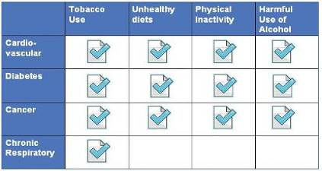
Non Communicable diseases
60% of mortality - 80% in LMICs - more than 40% premature
Main Noncommunicable diseases (NCDs):
Cardiovascular diseases
Cancers
Diabetes
Chronic respiratory diseases (COPD, asthma)
Preventable Risk factors for noncommunicable diseases:
Tobacco use
Unhealthy diet
Physical inactivity
Harmful use of alcohol
Notes:
8

Slide 9

Six Objectives of the Global NCD Action Plan
1. Integrating NCD prevention into the development agenda
2. Establishing/strengthening national policies and programmes
3. Reducing/preventing risk factors
4. Promote research for NCD prevention and control
5. Strengthening partnerships
6. Monitoring NCD trends and assessing progress made at country level
Under each of the 6 objectives, there are sets of actions for member states, for WHO and for international partners.
Notes:
9
Here are the objectives of the plan. Under each of the six objectives there are three sets of actions to be iplemented during the six year period, one set for member sates, another for WHO and a third for international partners

Slide 10
Primary Health Care Model
Cardiovascular disease
Chronic respiratory disease
Diabetes
Prevention of renal disease
Cancer
Notes:
10

Slide 11
Why Do We Need an Integrated Approach
Risk factors are shared and cluster together
Much common between heart disease and stroke
60% of diabetics die of heart attacks and stroke
Tobacco cessation is essential for improving outcomes of diabetes and CVD
Patients with CVD and diabetes can suffer from Chronic respiratory disease
Diabetes / hypertension commonest causes of renal failure
Too many guidelines and too little implementation
Notes:
11

Slide 12
A G E |  | MALE |  |  |  |  |  |  |  |  |  |  |  | FEMALE |  |  |  |  |  |  |  |  |  |  |  | SBP
 |  | Non-Smoker |  |  |  |  |  | Smoker |  |  |  |  |  | Non-Smoker |  |  |  |  |  | Smoker
 |  |  |  |  |  |  |  |  |  |  |  |  |  |  |  |  |  |  |  |  |  |  |  |  |  | 180
 |  |  |  |  |  |  |  |  |  |  |  |  |  |  |  |  |  |  |  |  |  |  |  |  |  | 160
70 |  |  |  |  |  |  |  |  |  |  |  |  |  |  |  |  |  |  |  |  |  |  |  |  |  | 140
 |  |  |  |  |  |  |  |  |  |  |  |  |  |  |  |  |  |  |  |  |  |  |  |  |  | 120
 |  |  |  |  |  |  |  |  |  |  |  |  |  |  |  |  |  |  |  |  |  |  |  |  |  | 180
 |  |  |  |  |  |  |  |  |  |  |  |  |  |  |  |  |  |  |  |  |  |  |  |  |  | 160
60 |  |  |  |  |  |  |  |  |  |  |  |  |  |  |  |  |  |  |  |  |  |  |  |  |  | 140
 |  |  |  |  |  |  |  |  |  |  |  |  |  |  |  |  |  |  |  |  |  |  |  |  |  | 120
 |  |  |  |  |  |  |  |  |  |  |  |  |  |  |  |  |  |  |  |  |  |  |  |  |  | 180
 |  |  |  |  |  |  |  |  |  |  |  |  |  |  |  |  |  |  |  |  |  |  |  |  |  | 160
50 |  |  |  |  |  |  |  |  |  |  |  |  |  |  |  |  |  |  |  |  |  |  |  |  |  | 140
 |  |  |  |  |  |  |  |  |  |  |  |  |  |  |  |  |  |  |  |  |  |  |  |  |  | 120
 |  |  |  |  |  |  |  |  |  |  |  |  |  |  |  |  |  |  |  |  |  |  |  |  |  | 180
 |  |  |  |  |  |  |  |  |  |  |  |  |  |  |  |  |  |  |  |  |  |  |  |  |  | 160
40 |  |  |  |  |  |  |  |  |  |  |  |  |  |  |  |  |  |  |  |  |  |  |  |  |  | 140
 |  |  |  |  |  |  |  |  |  |  |  |  |  |  |  |  |  |  |  |  |  |  |  |  |  | 120
 |  | 4 | 5 | 6 | 7 | 8 |  | 4 | 5 | 6 | 7 | 8 |  | 4 | 5 | 6 | 7 | 8 |  | 4 | 5 | 6 | 7 | 8
 |  | Cholesterol
Diabetes
WHO/ISH charts
Screen for risk of heart attacks and strokes
Using simple variables
Age
Smoking
Sex
Blood pressure
Blood cholesterol
Blood sugar
Intervene based on risk and affordability
Notes:
12

Slide 13
Noncommunicable Diseases & PHC
Prevent/protect
Detect cases early
Diagnose and treat
Follow up cases
Treat Emergencies
Prevent premature death
Improve adherence
Improve health outcomes
Reduce health care costs
Reduce complications
Reduce admissions to hospitals

Slide 14
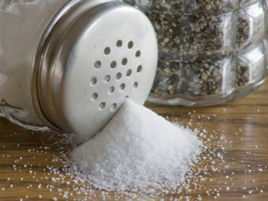

Background
There is direct a dose response relationship between salt intake and blood pressure
Reducing blood pressure by 10 mmHg → ↓ CHD events by 22%
Recommended Salt Intake: 6 g/person/day
In Palestine: 10-15 g/person/day
Notes:
Finland, Canada, France, Australia UK and new Zealand implemented population strategies and succeeded

Slide 15
Aim
To assess the cost-effectiveness of population-based interventions aiming to reduce salt intake and hence prevent coronary heart diseases and cancer .
Costs (Inputs)
Consequences (Outputs)

Slide 16
Package of Essential NCD Interventions for PHC

Slide 17

Introduction I
PEN: Package of Essential Non-communicable disease interventions for PHC in low-resource settings
It is a conceptual framework for strengthening equity and efficiency of PHC in
low-resource settings

Slide 18
Introduction II
It identifies core technologies, medicines and risk prediction tools; discusses protocols required for implementation of a set of essential NCD interventions
Develops technical and operational outline for integration of essential NCD interventions into primary care and for evaluation of impact

Slide 19

PEN Components

Slide 20
Mission
Achieve high coverage of essential interventions in low-resource settings.
Goal
Integration of core NCDs interventions into PHC and Development of tools for integration.

Slide 21
Expected outcomes of Integrating the PEN interventions in PHC
Reduce costs due to hospital admissions and complications
e.g. strokes, heart attacks, cardiac surgery, renal dialysis, etc.
Improve health outcomes and health equity in relation to CVD, DM, chronic respiratory disease and cancer
Strengthen primary care
Assist countries to use available resources efficiently

Slide 22
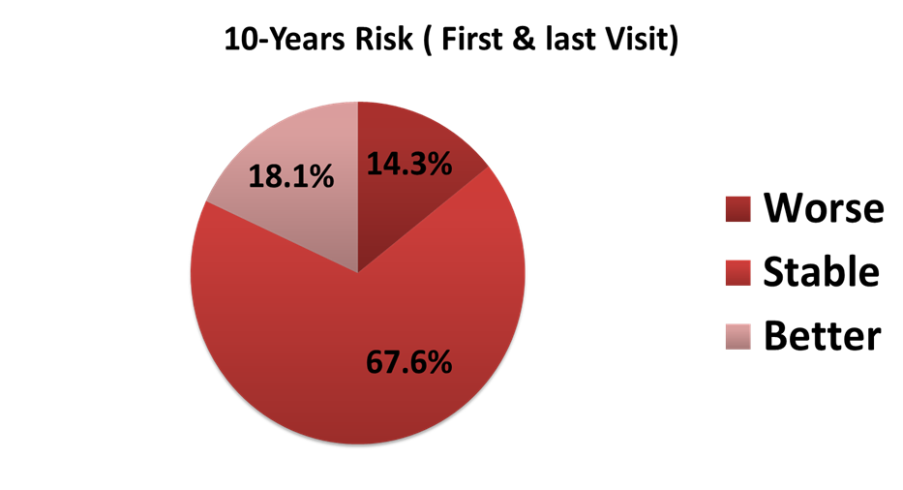
Change in CVD’s Risk

Slide 23


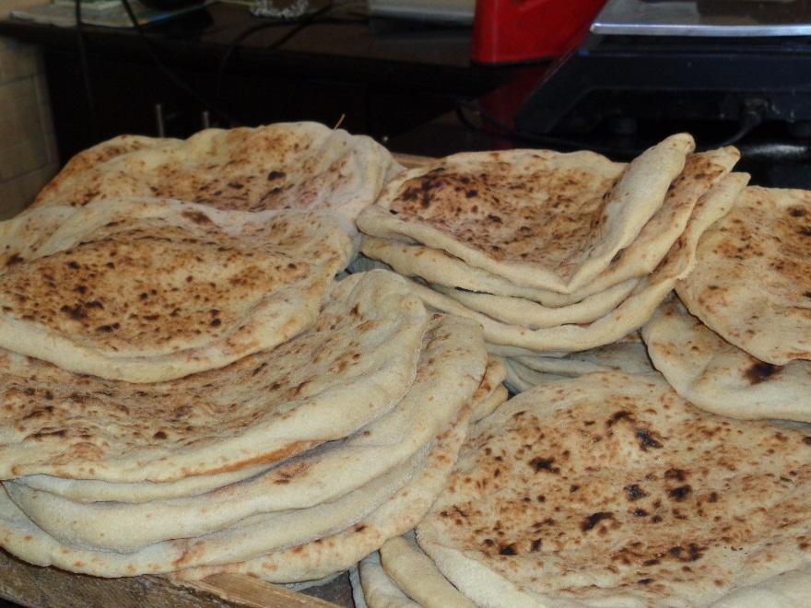
SURVEY OF BAKERIES ON SALT (AND SUGAR) IN BREAD

Slide 24

Population Level Interventions to Reduce the Burden of NCDs
Reduce content of salt in food
Substitute saturated fats with poly-unsaturated fats in diet
Increase awareness on healthy diet and physical activity
Ban smoking in public places
Inform on tobacco unhealthy effects, ban advertising and increase tax/price

Slide 25
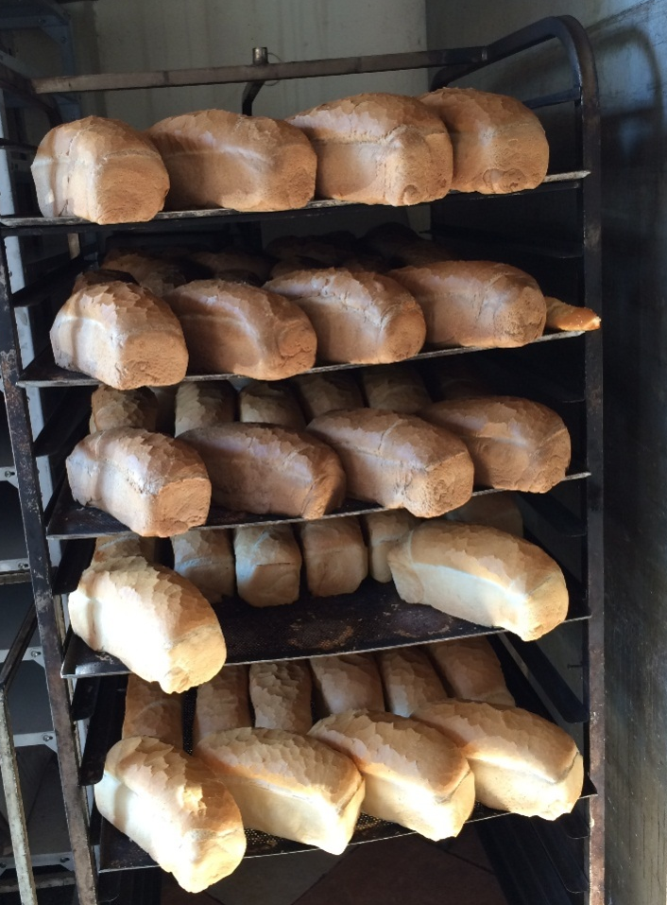
Why to Reduce Salt in
In the Arab countries, about 20% of the total salt intake comes from bread
In 2011 bread and cereals accounted for 16% of the average monthly household food cash expenditure (PCBS)
Bread is the single bigger contributor to salt intake due to its large consumption
Notes:
Six slices of bread contains 3 grams of salt

Slide 26
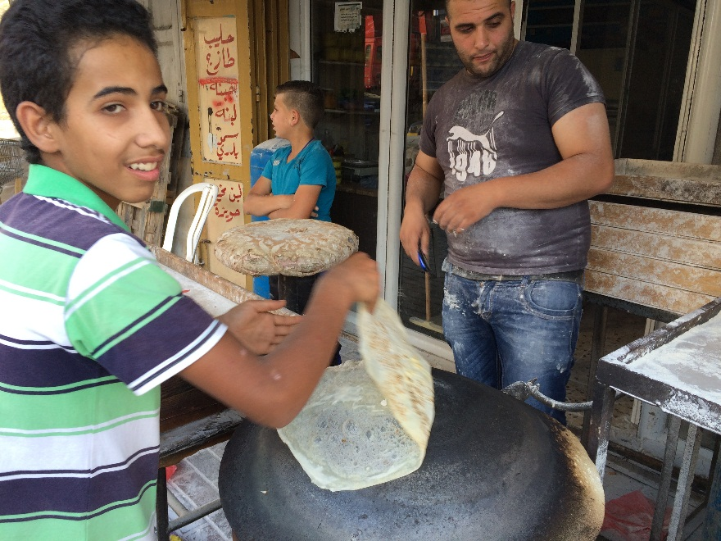
Preliminary Assessment to Plan the Survey
We performed a rapid assessment in 12 bakeries in Bethlehem, Hebron and Ramallah, to know how much salt (and sugar) is added to the flour
An high variability in the salt amount added to flour in relation to the type of flour
The average content in the flour resulted 1.3 gram of salt per 100 gram of flour

Slide 27
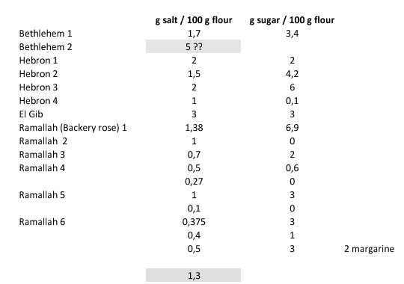
Results

Slide 28
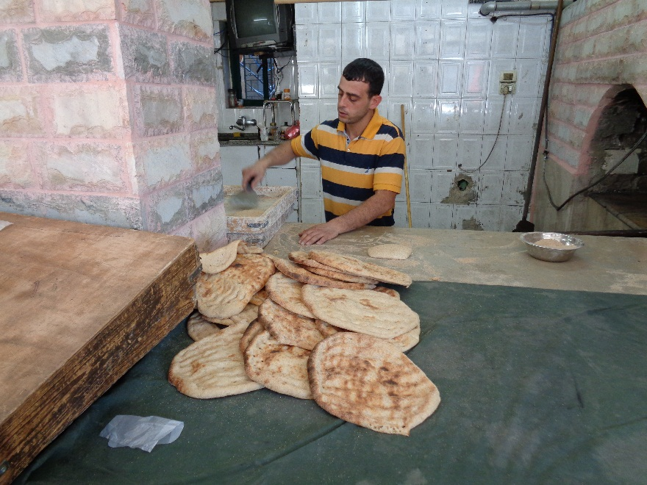
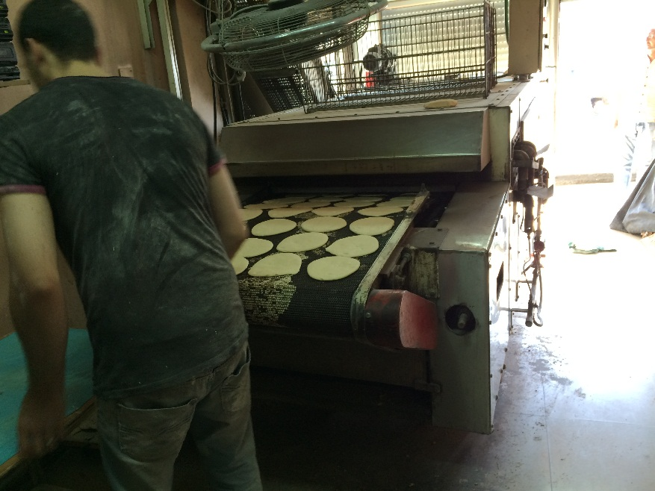
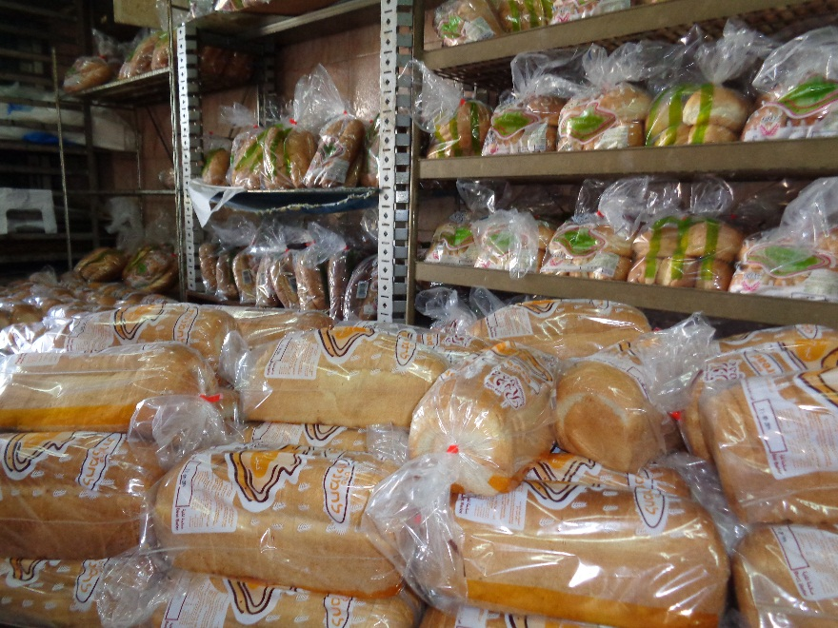
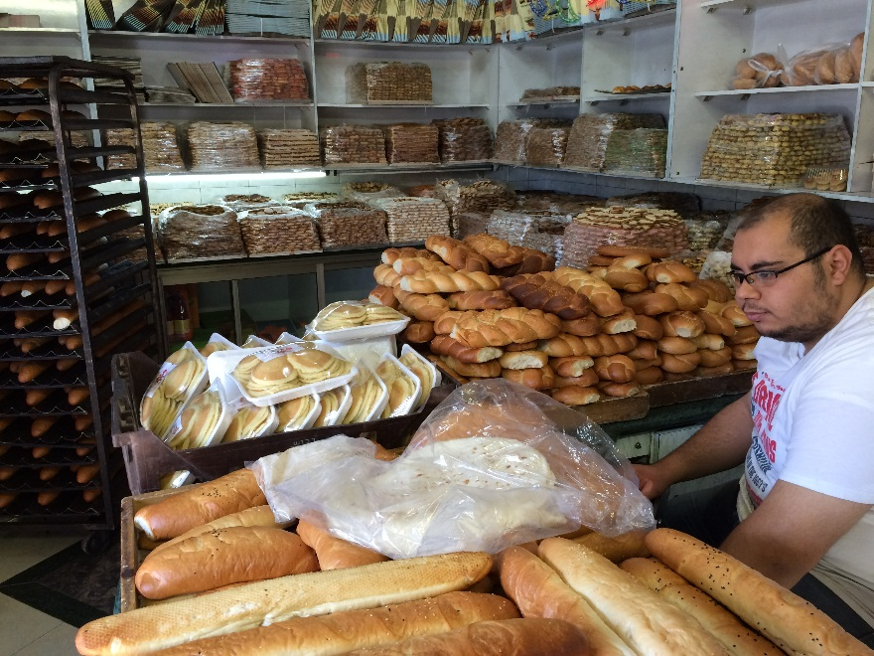

Slide 30
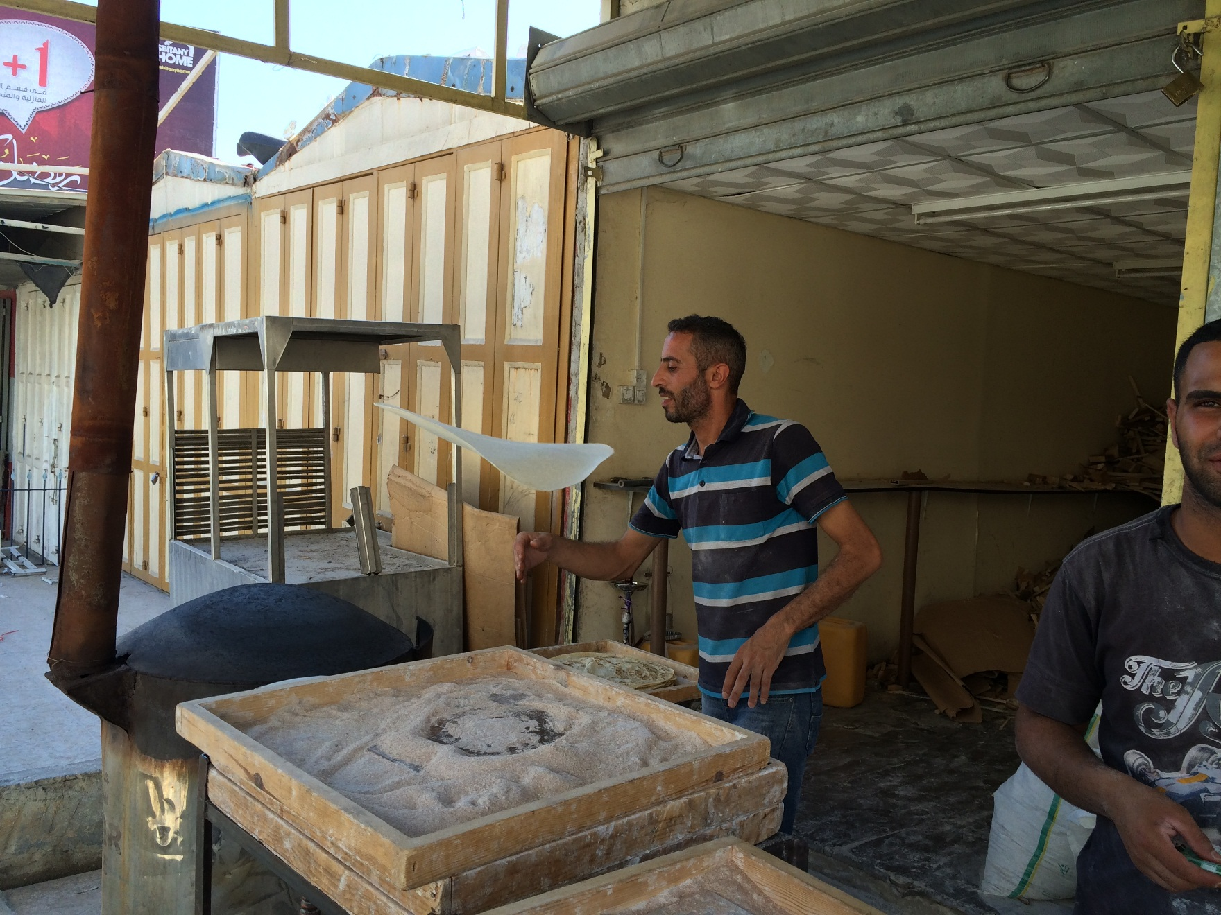

Slide 31
Investigated Products By Directorate
No. | Directorate | Product | Bread Product | Other Products
1 | Bethlehem | 31 | 27 | 4
2 | Hebron | 87 | 86 | 1
3 | Jenin | 21 | 21 | 0
4 | Jericho | 12 | 12 | 0
5 | Jerusalem | 17 | 17 | 0
6 | Nablus | 16 | 15 | 1
7 | Qalqiliya | 24 | 23 | 1
8 | Ramallah & Al - Bireh | 24 | 24 | 0
9 | Salfit | 11 | 11 | 0
10 | Tubas | 17 | 16 | 1
11 | Tulkarm | 29 | 29 | 0
* | Total | 289 | 281 | 8

Slide 32
The average addition of table salt to bread by directorate
No. | Directorate | Bread Product | Addition of Table Salt
 |  |  | Average (g / 100 g Bread) | Standard Deviation (g / 100 g Bread) | Minimum (g / 100 g Bread) | Maximum (g / 100 g Bread)
1 | Bethlehem | 27 | 1.0217 | 0.46089 | 0.40 | 2.40
2 | Hebron | 86 | 0.9771 | 0.45979 | 0 | 2.80
3 | Jenin | 21 | 1.0483 | 0.44062 | 0.05 | 1.60
4 | Jericho | 12 | 1.4333 | 0.71435 | 0.33 | 3.20
5 | Jerusalem | 17 | 0.9669 | 0.40223 | 0.57 | 2.00
6 | Nablus | 15 | 1.0707 | 0.47555 | 0.30 | 2.00
7 | Qalqiliya | 23 | 1.3710 | 0.78869 | 0 | 3.20
8 | Ramallah & Al - Bireh | 24 | 0.9722 | 0.58243 | 0.32 | 2.67
9 | Salfit | 11 | 1.1685 | 0.48101 | 0.53 | 2.00
10 | Tubas | 16 | 1.1702 | 0.28122 | 0.64 | 1.60
11 | Tulkarm | 29 | 0.9752 | 0.33149 | 0.20 | 1.60
* | Total | 281 | 1.0607 | 0.50781 | 0 | 3.20

Slide 33
The Average Addition of Table Salt, Sugar, Fat, Vegetable Ghee, Animal Ghee, Margarine & Hydrogenated Fat to Bread
No. | Ingredients | Average (g/100 g Bread) | Standard Deviation (g/100 g Bread) | Minimum (g/100 g Bread) | Maximum (g/100 g Bread)
1 | Table salt | 1.0607 | 0.50781 | 0 | 3.20
2 | Sugar | 2.2429 | 1.65077 | 0 | 8.00
3 | Total fat | 0.3243 | 1.03873 | 0 | 8.00
4 | Vegetable ghee | 0.0506 | 0.25887 | 0 | 2.00
5 | Animal ghee | 0 | 0 | 0 | 0
6 | Margarine | 0.1426 | 0.64302 | 0 | 6.67
7 | Hydrogenated fat | 0.0151 | 0.24572 | 0 | 4.00

Slide 34
Targeted Value Of Addition Of Table Salt To Flour Calculations
Situation | Table salt consumption (g/ day / capita) | Table salt consumption out of maximum recommended allowances | Table salt addition (g/ 100 g bread) | Table salt addition (g/ 100 g flour) | Table salt addition (Kg/ 100 Kgflour)
Current | 4.0 | 80% | 1.0607 | 1.3259 | 1.3259
Targeted | 2.5 | 50% | 0.6666 | 0.8333 | 0.8333

Slide 35
Conclusion
The table salt consumption coming from bread is very high in Palestine that gives 4.0 g/day/capita), which covers 80% of the maximum daily allowances of table salt.

Slide 36
Regulation
Involvement of PSI ( Palestinian Standard Institute )
MoH representative raised salt value to the board of PSI composed from different ministries and local institute.

Slide 37
Bread is the single bigger contributor to salt intake due to its large consumption
June 2015: Palestinian Standard Institute approved a framework regulation concerning nutrients in food
August 2015: MOH performed a survey on salt used by bakeries for bread preparation to establish a reliable salt reduction target
8 December 2015: PSI resolution 2015/37: salt reduction target at 1,3 grams x 100 grams of flour for 2016 (based on survey results)

Slide 38
Reg. Cont,,,
2. PSI board recommended to call for a technical meeting from different ministries & Institution concerned
3. Palestinian technical committee recommended the average of the survey 1.3 gm salt / 100gm of flower
4. The technical committee recommendation will approved by PSI board, then it will be considered as technical regulation = laws.

Slide 39


