Slide 1



Overview MED-TSO experience
LAS Knowledge Sharing
Dammam (KSA)
12 May 2024
Co-funded by
the European Union

Slide 2
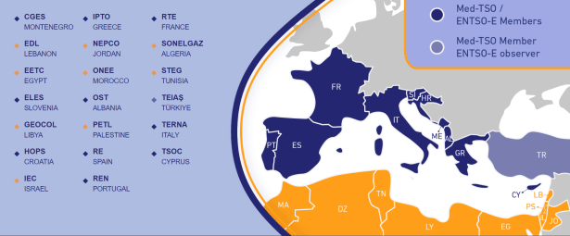
Med-TSO: multilateral cooperation in the Mediterranean
20 members from 20 Med countries
> 500 million people served
~ 544.000 MW installed capacity
~ 400.000 km transmission lines
> 1.600 TWh electricity consumption
A bridge between Europe and the MENA Region, acting as THE reference regional stakeholder for electricity
Playing a regional reference role for creating a favorable climate for the development of North-South and South-South interconnections
Launching pilot projects to strengthen the integration of the MENA Power Systems
Support the EC in its Euro-Mediterranean initiatives
Bottom-up approach
2

Slide 3
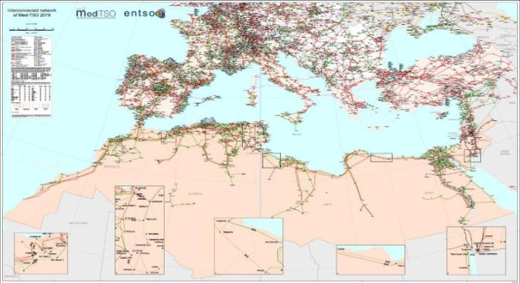
The Mediterranean electricity map
First issue to tackle: promoting the development of the grid
Notes:
The first issue to tackle: promoting the development of the grid
The current status of grid interconnection in the Mediterranean region shows three different situations:
a sufficient level of in interconnection within the North Mediterranean countries, with a number of new projects going to enter into operation in the next years to fulfil the interconnection targets fixed at EU level
an insufficient interconnection level within the South Mediterranean countries, also with limited utilization and synchronization difficulties;
Morocco and Algeria are linked through three AC lines for a TTC of 2 500 MW and a NTC of about 1 000 MW.
Algeria and Tunisia are linked through four AC lines with a TTC of 1 500 MW and a NTC of about 300 MW.
Tunisia and Libya have two AC lines (3 circuits) normally not operated due to stability problems
Libya and Egypt are connected by a 220 kV double circuit line operational since 1998
Egypt and Jordan operate since 1998 a 400 kV AC submarine cable (13 km) crossing the Aqaba Gulf with a commercial transfer capacity of 500 MW.
Syria used to be connected with Jordan, Lebanon, Iraq and Turkey, but these lines are currently not operated.
As far as Turkey is concerned, there are occasional exchanges to so-called “electricity islands” in Northern Syria that are temporarily isolated from the Syrian main grid, and also to Georgia and Iran that do not correspond to a synchronous operation of the power systems.
a poor North-South interconnection, limited in volume and topology, with only two links at the western and eastern extremities of the ring.
Interconnection Morocco – Spain, two 31 km 400 kV submarine AC links that puts the integrated grids of Morocco, Algeria and Tunisia in the Maghreb region into synchronous operation with the ENTSO-E system (1400 MVA TTC)
Interconnections between Turkey and Greece (1x400kV) and between Turkey and Bulgaria (2x400 kV), entered in 2010 in synchronous operation with the Continental Europe Synchronous Area (CESA). Promoting the development of the transmission grid, both assessing the feassibility of new investments and how to imporve the efficiency of the existing ones, is one of Med-TSO major tasks.

Slide 4



Main pillars of Med-TSO’s action plan
a
b
c
d
Coordinated planning
Common rules
Capacity building
Interconnected Electricity Exchange Zones
  Coordinated development of HV grid
  Med Masterplan
  Power System interoperability
  Mediterranean Grid Code
  Training
  Knowledge Sharing programs
  Coordinated Adequacy assessments
  Enhance coordination in operations
2015
2018
2020
2023
2025
2
4

Slide 5
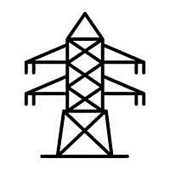




TEASIMED 2 Project (2023-2025)
Project workstreams
CONSOLIDATION OF THE COMMON TECHNICAL REGULATORY FRAMEWORK
ASSESSING RESILIENCE OF POWER SYSTEM
4
2
1
5
UPDATE OF THE MEDITERRANEAN TRANSMISSION NETWORK DEVELOPMENT PLAN
3
KNOWLEDGE SHARING PROGRAMME FOR TRAINING AND CAPACITY BUILDING
OPTIMISED OPERATION PROCESSES
5

Slide 6
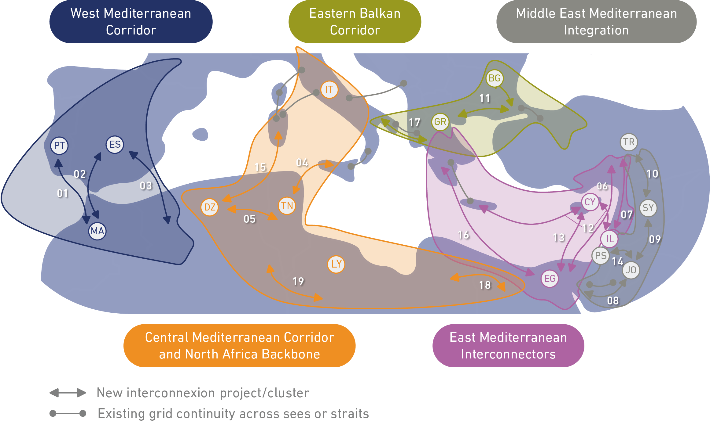
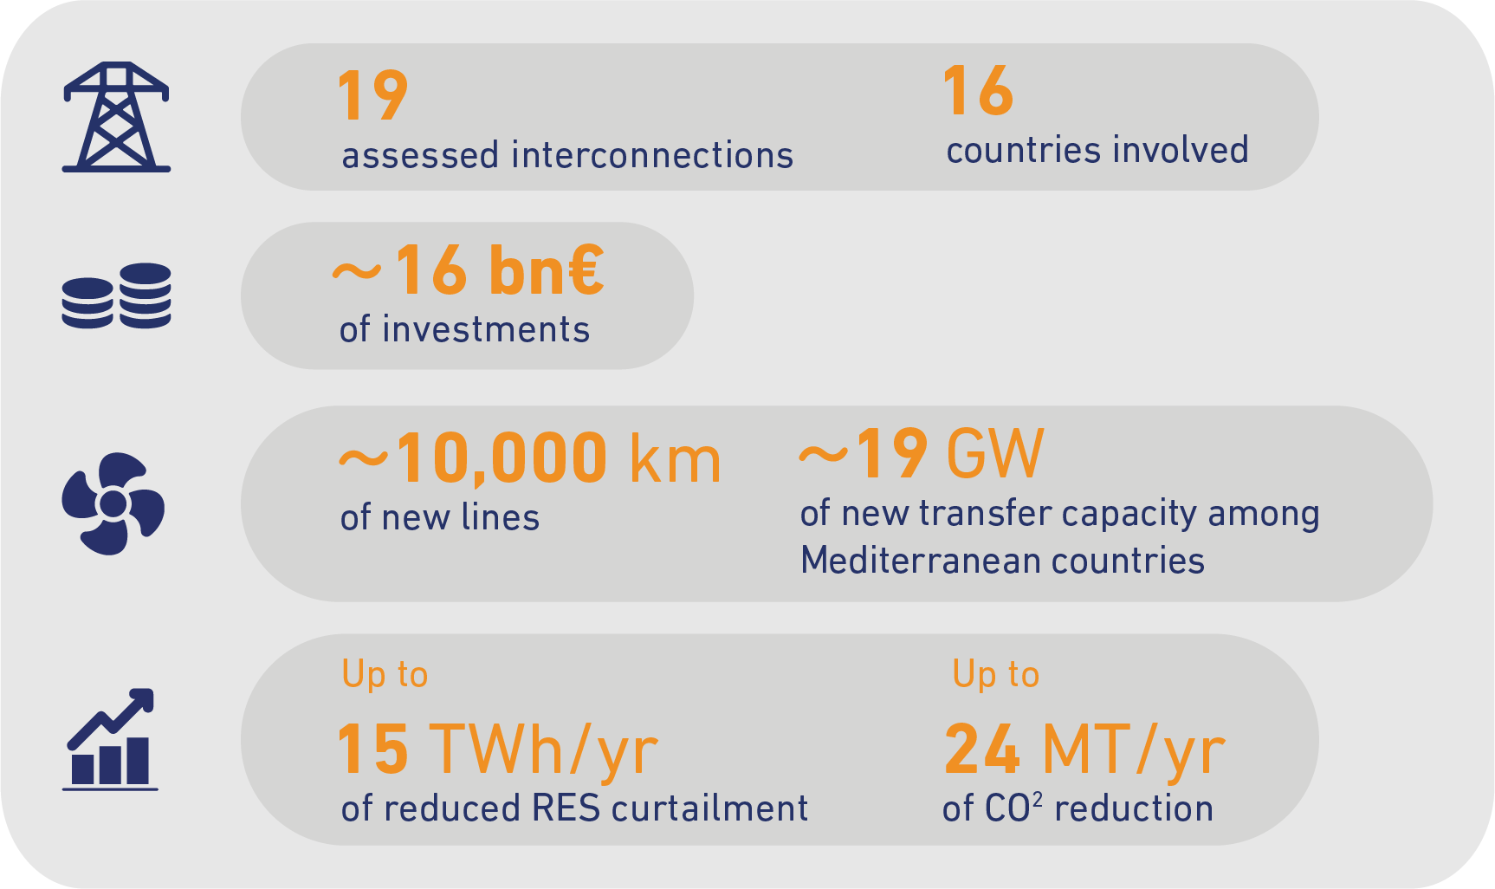
TEASIMED 2022 Master Plan outcomes
https://masterplan.med-tso.com
https://data.med-tso.com
6

Slide 7
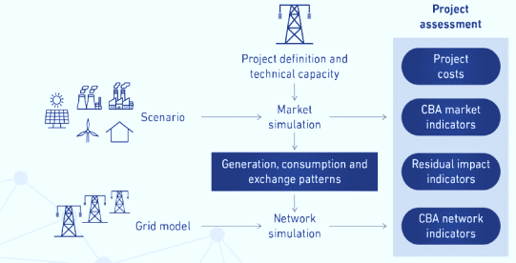
2025 long term planning assessment
Set of coherent activities:
definition of consistent energy scenarios for 2030 and 2040
Update the assessment of mature projects with renewed 2030 scenarios
Selection of the future interconnection projects for the horizon 2040
set up of a reference model of the regional power system to perform market and network studies
Network behavior (load flow calculations) and investments to fulfil security requirements
Perform a shared Cost-Benefit Analysis (CBA) for the new investments
Assess 2040 horizon for the first time

Slide 8


Building the software for the Mediterranean Power Systems
Support institutional initiatives:
    EC initiative for the Mediterranean Grid Code with a particular focus on the management of international interconnections (allocation and capacity calculation)
    Possible support to the PAEM initiative
Promote the efficient operation of interconnected electrical systems: use of data exchange web platforms and common protocols
Support to the members for specific studies: synchronization test of the North Africa and Middle East from Algeria to Jordan
FR
SL
HR
IT
ME
ES
AL
PT
GR
TR
CY
LE
MA
ZONE 1
TN
PS
DZ
IL
JO
LY
EG
ZONE 2
ZONE 2
Strong institutional support required
Trading areas connected to the EU IEM: win-win integration among EU and non-EU countries
8

Slide 9
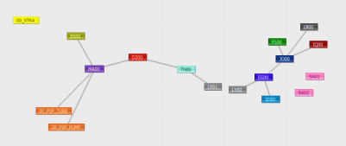

TEASIMED 2 results: adequacy assessment
European TSOs regularly assess and control system adequacy
Similar investigations carried out for the first time ever to non-EU Med-TSO members
Reports providing information about potential adequacy issues in 7 MED-TSO members (Morocco, Algeria, Tunisia, Libya, Egypt, Jordan and Lebanon):
  Summer Outlook
  Winter Outlook
  Mid-term Adequacy Forecast
9

Slide 10
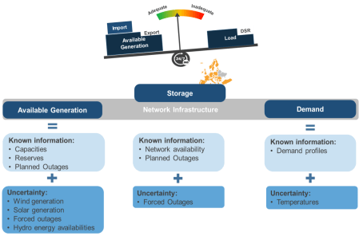
Why a coordinated adequacy assessments?
Coordinated adequacy assessment to help answering Security of Supply questions like:
  Does the country ‘A’ have enough capacity to cover power demand even under severe/extreme conditions?
  How the interconnection could reduce shortage situations?
A power system is adequate when sufficient production and import capacity allow demand to be met, guaranteeing security of supply
10

Slide 11
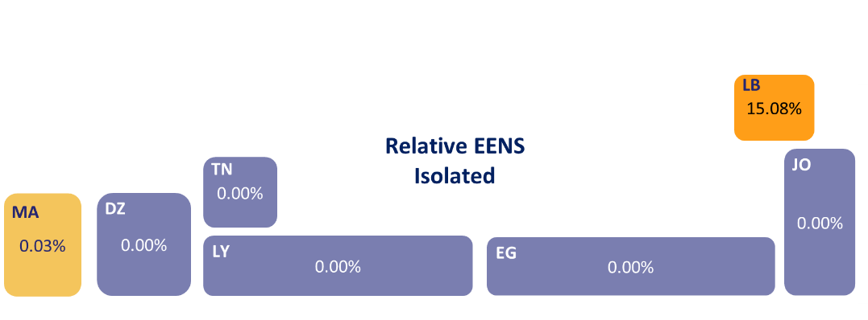
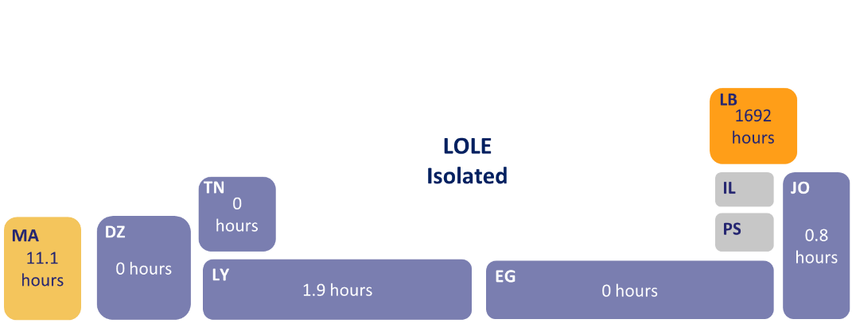
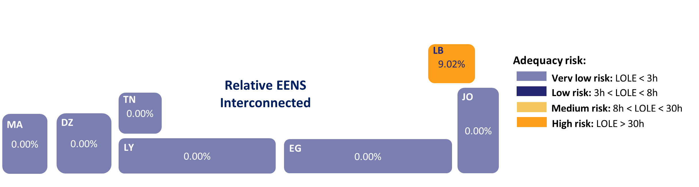
Winter Outlook 23/24 – isolated operation
Significant adequacy issues are registered in Lebanon and medium risk in Morocco
Lebanon average Maximum daily LOLE during the whole season can be ranged from 4 hours to 17 hours & is facing around 56% LOLE during winter season.
For Libya we can see adequacy risk is at minimum due to the increase of thermal fleet in the input data
Isolated operation regime is more hypothetical case, indicating importance of the interconnections
The systems that are adequate even in isolated mode of operation can be treated as self sustainable.
56%
Winter season
11

Slide 12
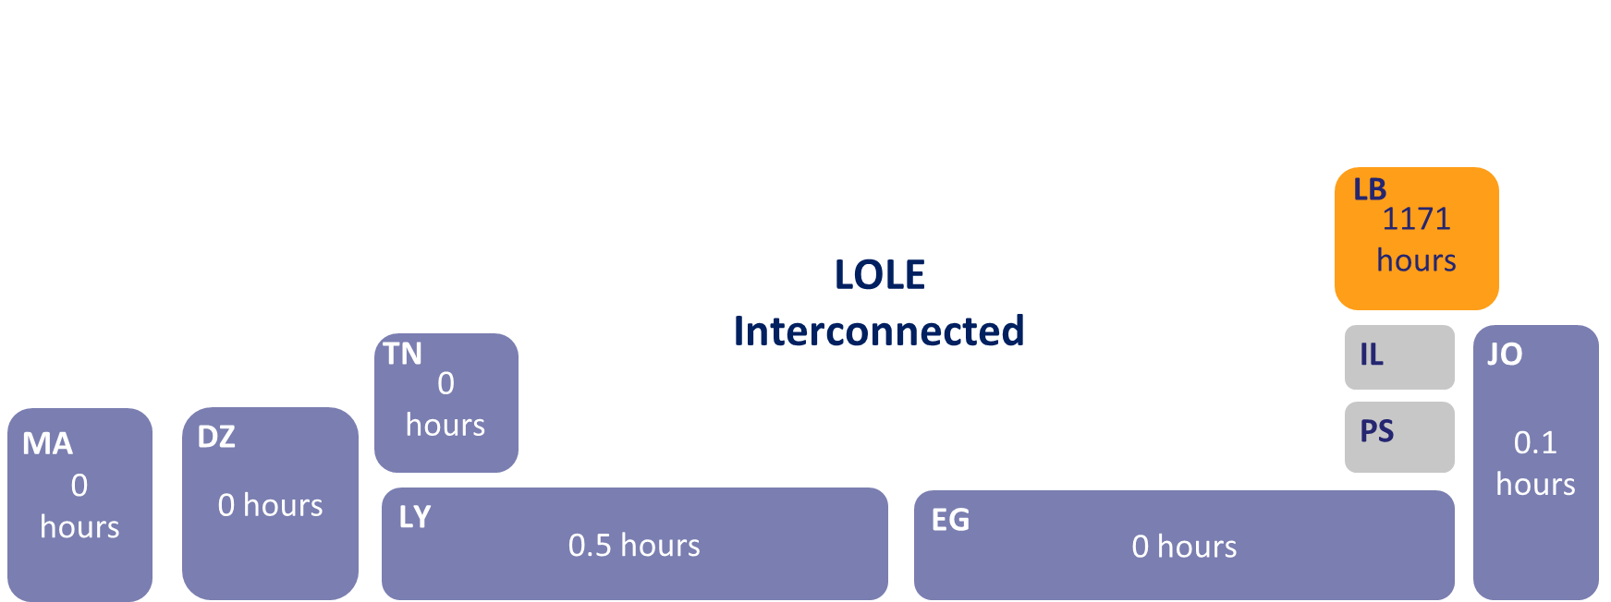
Winter outlook 23/24 –interconnected operation
Adequacy situation is better than in isolated mode
As a sensitivity we also assessed the interconnection of Lebanon with Jordan through Syria enabling an import up to 250 MW
average Maximum daily LOLE during the whole season can be ranged from 2 hours to 14 hours & is facing difficulties around 38% LOLE during winter season only.
Severe adequacy issues are still registered in Lebanon (high adequacy risk)
38%
Winter season
12

Slide 13
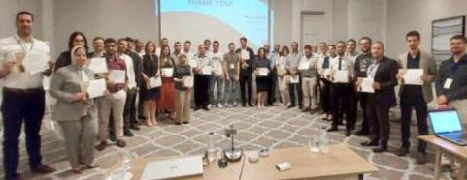
Knowledge Sharing and Capacity Building
  Cooperation for enhancing Members capacities and share experiences
    During TEASIMED
    96 TSO experts trained on energy regulation
    2 training sessions on Adequacy Assessment
    12 thematic webinars and workshops with Stakeholders
    Foreseen in TEASIMED 2
    Continuous Members’ training on market modelling and adequacy simulation tools
    Workshops on resilience and flexibility
    Technical visits
13

Slide 14








Cooperation with main stakeholders
  Supporting Med-TSO work programme since 2015
  Starting cooperation with League of Arab States on some common dossiers
Gradual approach
No one-size-fits-all solutions
Sub-regional approach
Med-TSO is active stakeholder in Ufm REM Platform
Cooperation framework since 2014
  Long-term joint cooperation agreement since 2017
Protocol of cooperation signed in 2022 (together with OME & MEDENER)
Cooperation within UfM energy platforms and strengthened collaboration for the development of long-term energy scenarios
14

Slide 15
thank you!
Co-funded by
the European Union

